Slide 1

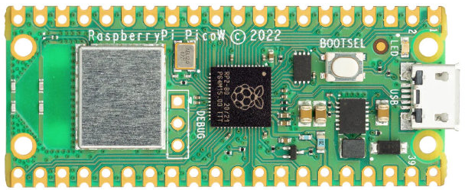
NLB PI PICO CLUB – 2023
Focus 2023 –
Learning the functionality and application of sensors
In depth Python Programming
Web Servers / Cloud Services
Databases – MYSQL, InfluxDB
Visualization Tool – Grafana / Thingspeak / Blynk
Individual or Group IOT Projects

Slide 2
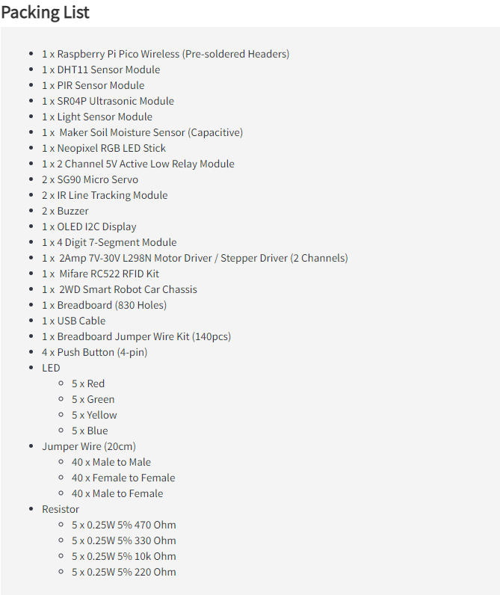
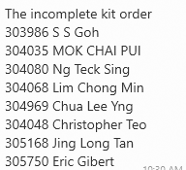

Slide 3
SETTING UP – Breadboard
SETTING UP THE PICO W FOR THE FIRST TIME
PICO POWER AND GROUND RAIL

Slide 4
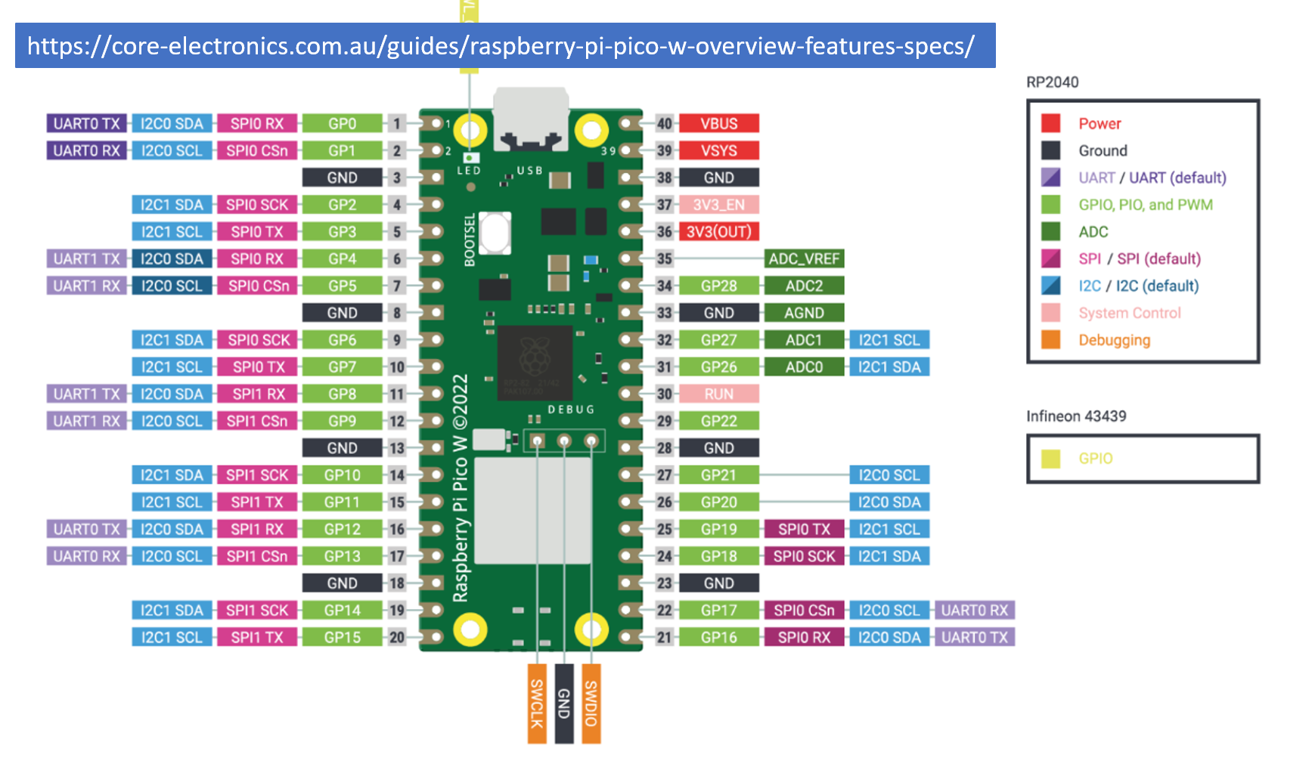


Slide 5
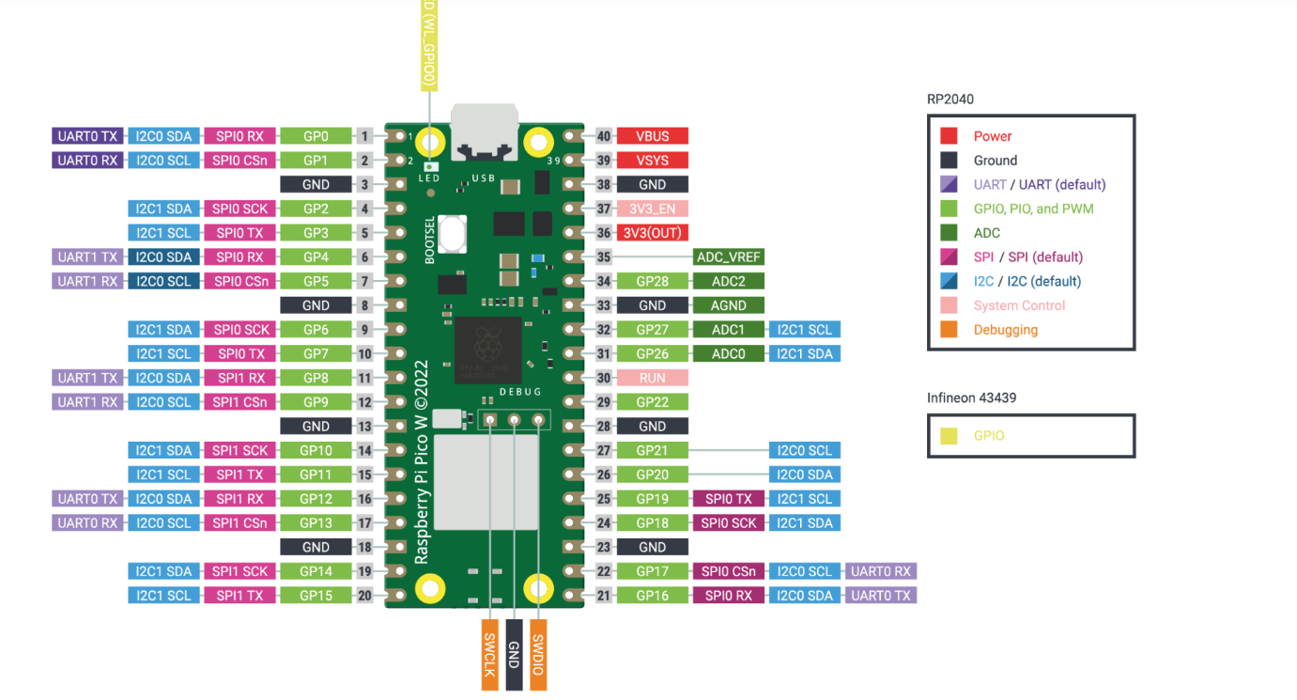
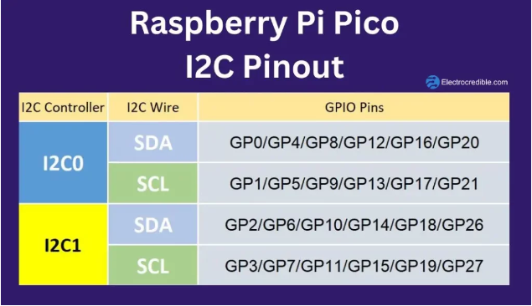
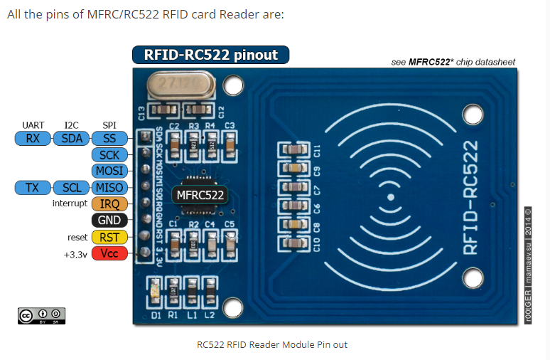
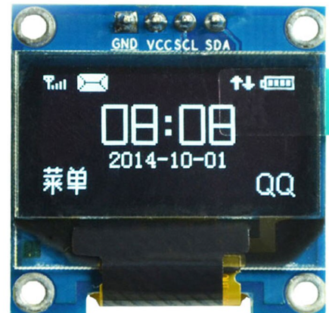
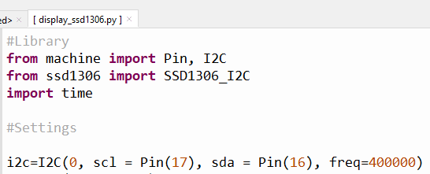
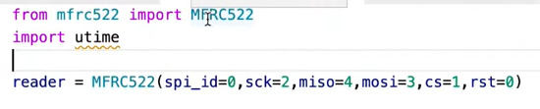
https://core-electronics.com.au/guides/raspberry-pi-pico-w-overview-features-specs/
i2c i Square C
SPI Serial Peripheral Interface UART Universal Asynchronous Receiver Transmitter.

Slide 6
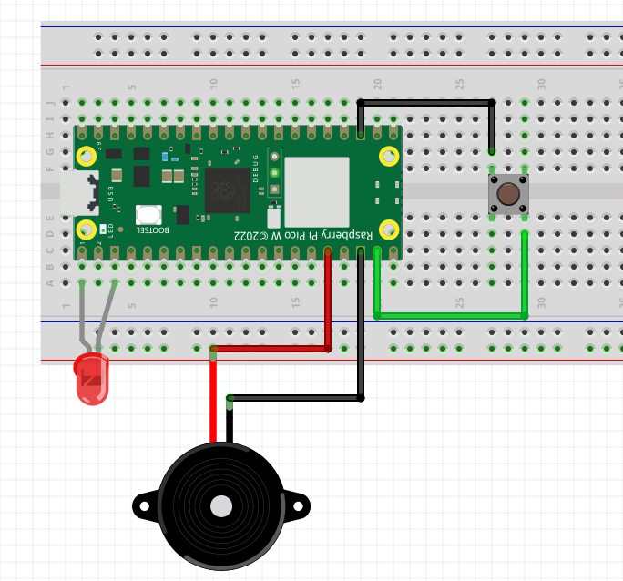
Introduction to LED Button and Buzzer
Micropython machine Library
GND
GPIO 14
GPIO 0
GPIO 12
GND
GND

Slide 7
PYTHON PROGRAMMING – STRINGS, NUMBERS, TUPLES
WIRING UP SSD1306
Temp/Humidity Sensor dht11 and SSD1306
Strings and Numbers
Getting date and time from the Pico that is attached to your computer
(2023, 1, 5, 17, 0, 11, 3, 5)
Understanding Data Type – Tuples
Light Sensor Experiment / Thonny Plotter
Light Sensor Writeup

Slide 8
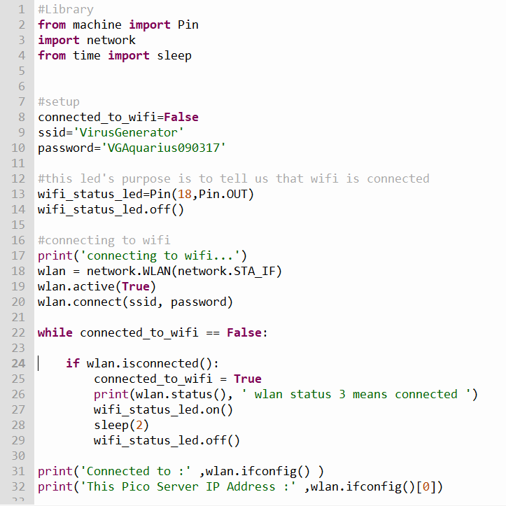
Connecting to Wifi
Ssid: VirusGenerator
Pwd: VGAquarius090317
Here we have another
Example of the datatype
Tuple

Slide 9
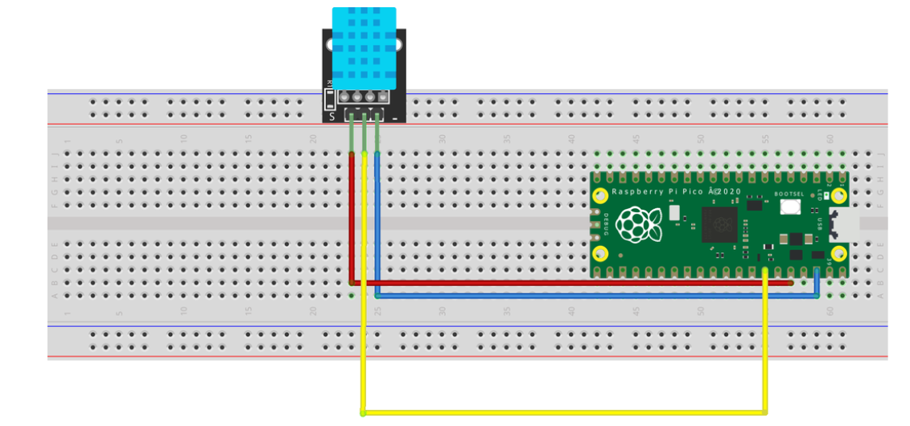
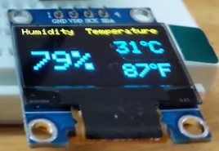
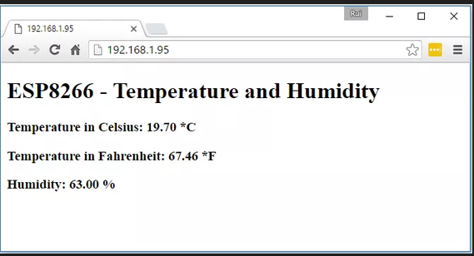
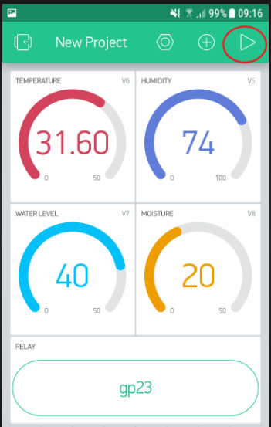
Pico as Webservers
Connected to : ('192.168.1.95', '255.255.255.0', '192.168.1.1', '192.168.1.1')
Blynk
wifi
Convert Pico W to WebServer

Slide 10
Pi Club Repository on Github
https://github.com/ssgoh/The-Pi-Club

Slide 11
Self learning video lessons.
Compiled by Mr Yap
https://www.youtube.com/watch?v=Kpzqlm-FHvc
Getting started with Raspberry Pi Pico Board
https://www.youtube.com/watch?v=4XPDyKujcxI
Analog (ADC)
https://www.youtube.com/watch?v=IsWgnU71OiY
Digital Inputs
https://www.youtube.com/watch?v=hqudYm-a_aU
PWM – Pulse Width Modulation

Slide 12
from machine import Pin
from time import sleep
button = Pin(14,Pin.IN,Pin.PULL_UP)
buzzer = Pin(12,Pin.OUT)
led = Pin(0,Pin.OUT)
while True:
print(button.value())
if button.value()==0:
print('pressed')
led.on()
buzzer.high()
else:
print('no press')
led.low()
buzzer.off()
sleep(1)
SHOULD BE Pin.PULL_UP and NOT PULL_DOWN
SHOULD BE == 0

Slide 13
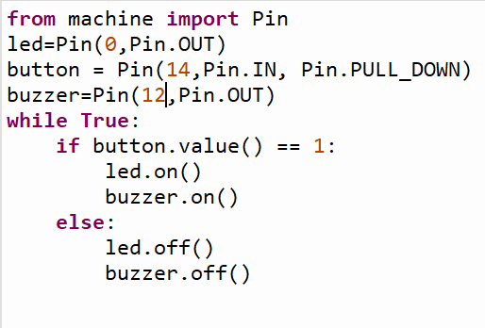
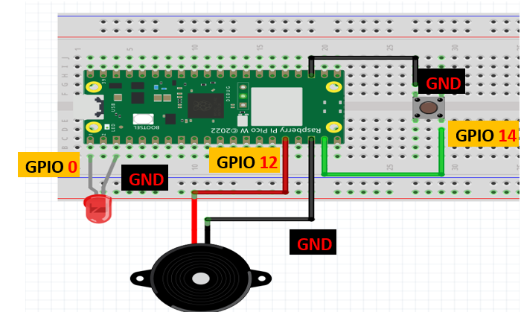
For this program to work with internal PULL_DOWN
Resistor, the button must be wired to 3V3 instead of GND. The button will have value == 0 until it is pressed.
PROGRAM GIVEN OUT AS EXAMPLE YESTERDAY
3V3
3V3
GPIO 14
GPIO 0
GPIO 12
GND
GND
PROGRAM IS CORRECT BUT THE ORIGINAL WIRING DIAGRAM WAS WRONG

Slide 14
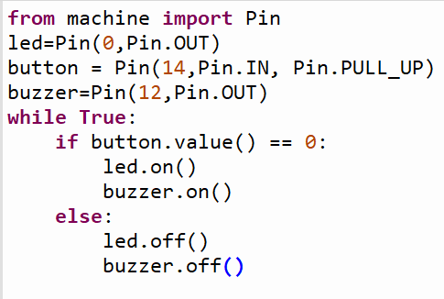
If button is connected to GND, we need to set the internal resistor to PULL_UP instead.
However, in this situation the button value is High when it is not pressed, and Low when it is pressed.
Therefore we need to change our logic to turn on LED and buzzer when button is LOW (pressed) and turn off LED and buzzer when button is HIGH (not pressed)
GND
GPIO 14
GPIO 0
GPIO 12
GND
GND

